Slide 1

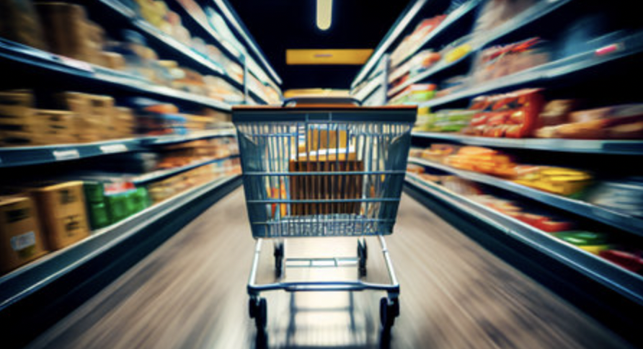
FRESHCO HYPERMARKET
CAPSTONE
PANKAJ KHATRI

Slide 2
01
Order Level Analysis
02
Completion Rate Analysis
Contents
03
Customer Level Analysis
04
Delivery Analysis

Slide 3
Order Level Analysis
Objective
To analyze customer purchasing behavior by examining order distribution across delivery slots and areas, trends in monthly order volumes, and the impact of delivery charges and discounts.
Findings
-Analysis has shown order distribution across different slots and areas, providing insights into most peak hours and high-demand locations.
-By comparing monthly order from January to September, it has been seen that areas such as HSR Layout, ITI Layout and Harlur have 20912 orders flagged out of total 22823. Resulting in 91.62% of total orders. Over the year there has been increase in order counts in HSR Layout and ITI Layout. Whereas, in Harlur order count has typically increased in the month of August and September, giving an idea of potential growth over the time.
-Calculations like delivery percentage, discount percentage at slot level are done by predefined criteria.
58%

Slide 4
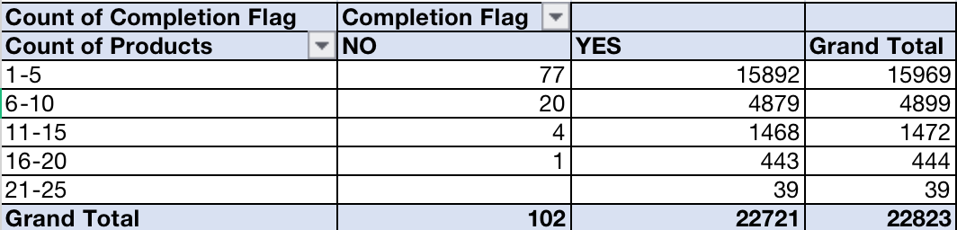
Completion Rate Analysis
Objective
To evaluate the efficiency of order fulfillment processes by analyzing completion rates across different delivery slots, days of the week, and drop areas.
Findings
-Harlur, ITI Layout and HSR Layout have completion rate of 99.69%, 99.59% and 99.60%respectively. Indicating that Freshco is performing exceptionally well in this areas in all slots.
-Completion rate at Slots level indicates that afternoon slots have highest orders over the week, whereas Late night slots have the lowest. There has been significant orders on Friday and Saturday which haven’t been completed. Further data is required to understand the cause behind failed deliveries.
-Generally orders which has less than 10 items in it are failed to be delivered, compared to orders which has more than 10 items.
58%

Slide 5
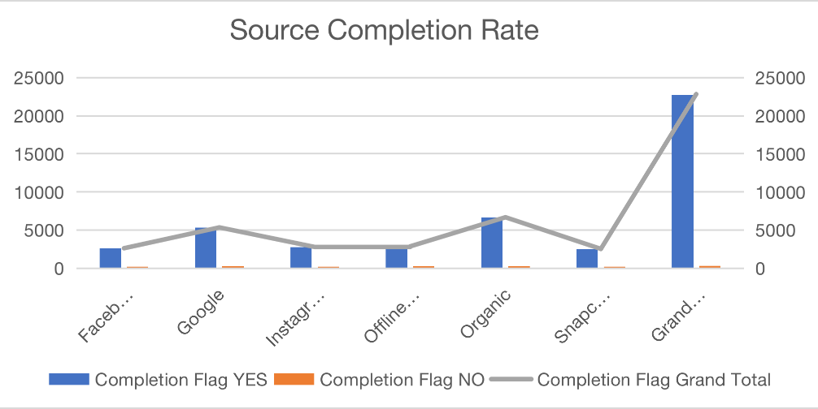
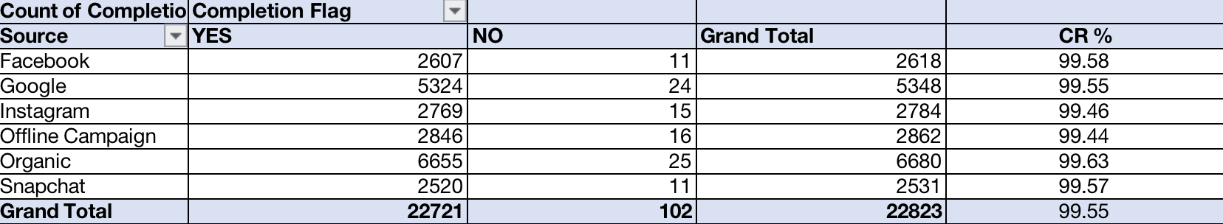
Customer Level Analysis
Objective
To gain insights into customer behavior and value by calculating
LTV for each customer and aggregating LTV at acquisition source and month levels. Additionally, this analysis examines average revenue per order by acquisition source and month along with Completion rate at source level.
Findings
-Identifying completion rate at source level shows effectiveness in terms of order fulfillment.
-Calculating LTV and aggregated LTV provides long term value that each customer brings to Freshco. This provides analysis in identifying the most promising acquisition channel and show the effectiveness of marketing campaigns over the time period (January to September).
-Average revenue help understanding the revenue generated from different sources and trends over time.
-Order with rating 5, has the highest total of discount provided by Freshco.
58%

Slide 6
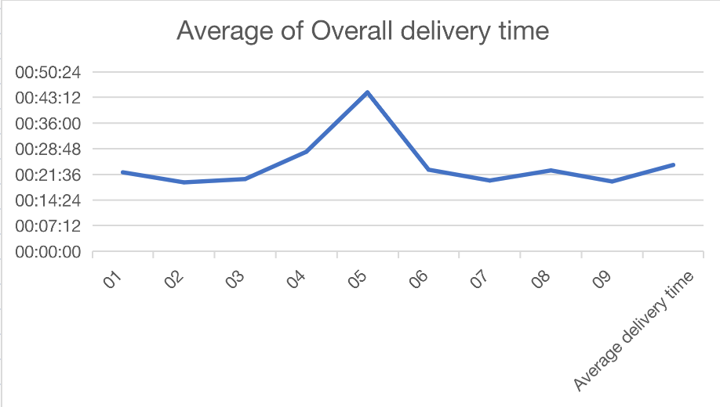
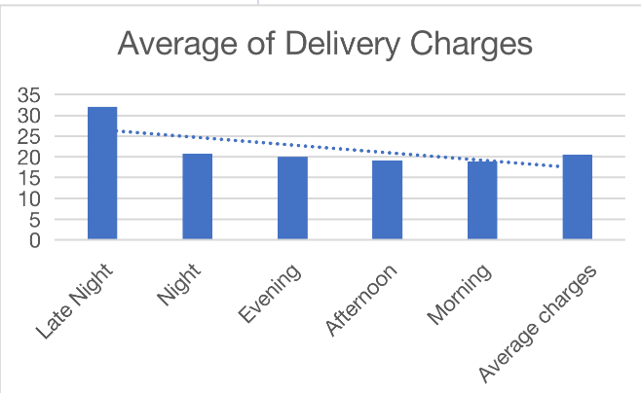
Delivery Analysis
Objective
Analyzing Delivery performance on month and drop geo metrics helps Freshco understands the performance efficiency.By comparing weekend and weekday delivery time aloing with slots helps to understand which months are busy compared to others.
Findings
-The average delivery time at month and delivery area helps in understanding the delivery performance variation across different region over time period.
-Average delivery time is calculated on monthly basis, segregated by weekday and weekend. It provides insights on delivery performance based on day of the week.
-Overall delivery time at slot level provides that average delivery time is usually less for late night slots.
58%

Slide 7
The comprehensive analysis reveal insights across various operational aspects of the business. Order distribution identified demand areas, with significant groeth in HSR Layout and ITI Layout. Completion rates were highest in key areas, with afternoon slots performing the best. Customer analysis highlighted the effectiveness of different acquistion sources and the long-term value of customers. Delivery analysis showed variations in delivery times across regions and times, indicating areas for optimization. These insights will help Freshco to enhance efficiency, improve customer satisfaction and drive long-term growth.
Conclusion

Slide 8
Thank You

